Slide 1
The Best Neighborhood

Slide 2
As a citizen in Shanghai now, I enjoy my living neighborhood. I may have expatriate opportunity to relocation to Manhattan for a short term assignment. Business Problem: The objective is to find a suitable apartment in Manhatton with similar neighborhood environment to mine in Shanghai. The apartment better meet below standards: - 2 bedrooms - near a metro station in the Manhattan area - rent < $7,000 per month - similar neighborhood environment to mine in Shanghai
Description of the problem

Slide 3
The below data is required to answer this problem: List of Boroughs and neighborhoods of Manhattan with their geodata (latitud and longitud) List of Subway metro stations in Manhattan with their address location List of apartments for rent in Manhattan area with their addresses and price Preferably, a list of apartment for rent with additional information, such as price, address, area, # of beds, Venues for each Manhattan neighborhood Venues for subway metro stations The data will be used in below methods: Use Foursquare and geopy data to map top 10 venues for all Manhattan Use foursquare and geopy data to map the location of metro stations Use Foursquare and geopy data to map the location of rental places Draw the map that depicts the average rental price around a radious of 1.0 mile around each metro station Interested Audience: Level1: People with potential arrangement to move to Manhatton Level2: People with potential arrangement to move to another city Level3: Individual with interests in finding a specific spot with designed criteria
Description of the data and method

Slide 4
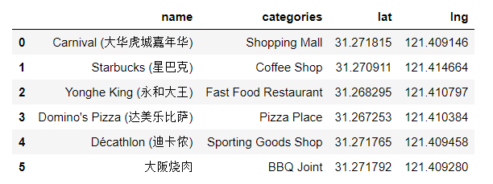
Nearby Venues of Current Location in Shanghai Home

Slide 5
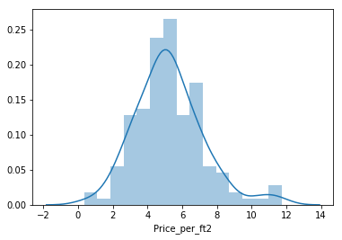
Manhattan apartment rent price statistic

Slide 6
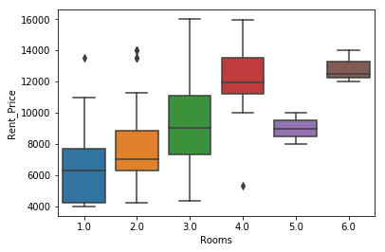
Manhattan apartment rent price statistic

Slide 7
After examining, two locations best fit the requirements: Apartment 1: 305 East 63rd Street in the Sutton Place Neighborhood and near 'subway 59th Street' station, Cluster # 2 Monthly rent : 7500 Dollars Apartment 2: 19 Dutch Street in the Financial District Neighborhood and near 'Fulton Street Subway' station, Cluster # 3 Monthly rent : 6935 Dollars
Problem Resolution

Slide 8
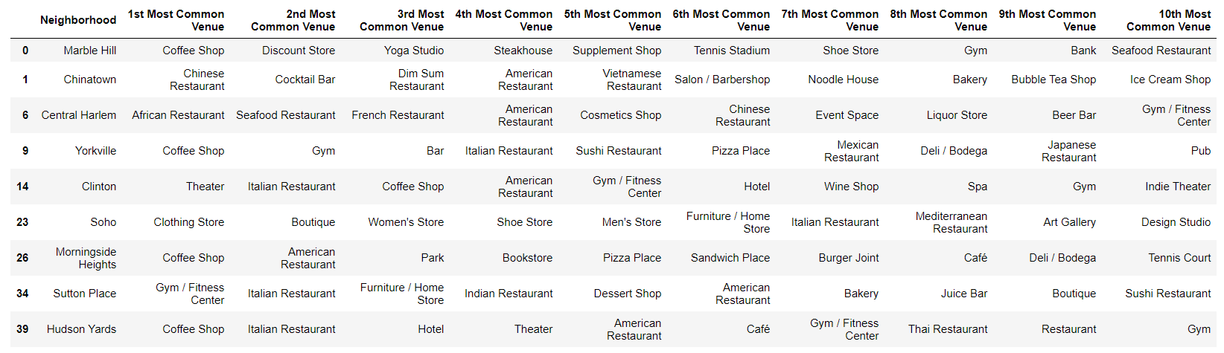
Results: Venues for Apartment 1

Slide 9
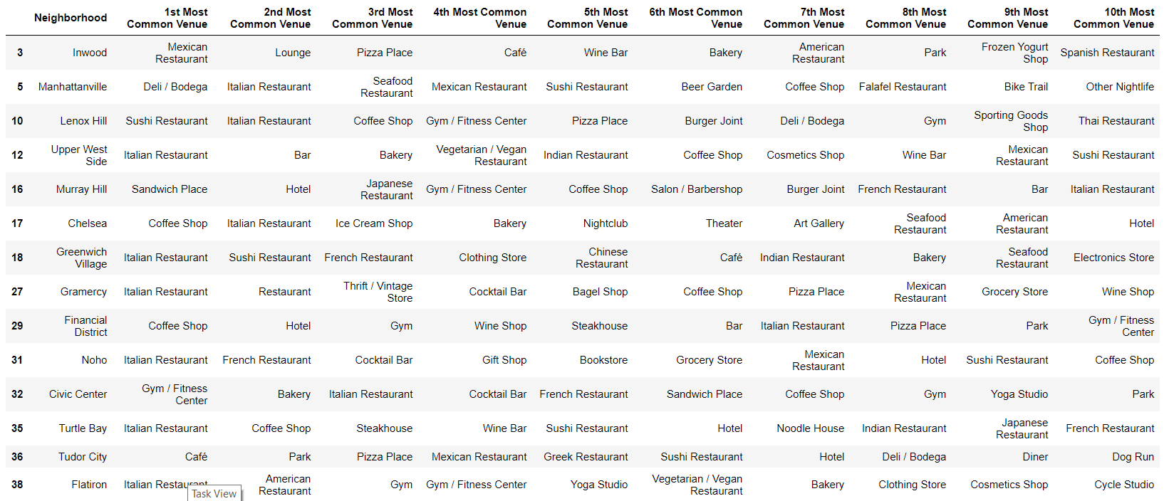
Results: Venues for Apartment 2

Slide 10
Compare with current Shanghai home, Cluster 2 type of venues is a closer resemblance, which concludes that APARTMENT 1 is a better choice since the extra rent cost is worth the conveniences it provides.
Conclusions

